Slide 1
Data Science in Practice: Examining events in social media

Slide 2
Everyone Deserves SuprFanz.
Unique technologies to drive traffic to events via social media.
Notes:
My name is Jen Webb and I’m a co-founder of SuprFanz, a cloud-based event marketing company.

Slide 3
Agenda:
Introductions
Company SuprFanz – our story
What we do
How data science can help our customers
Graph Algorithms and Examples
Next Steps

Slide 4
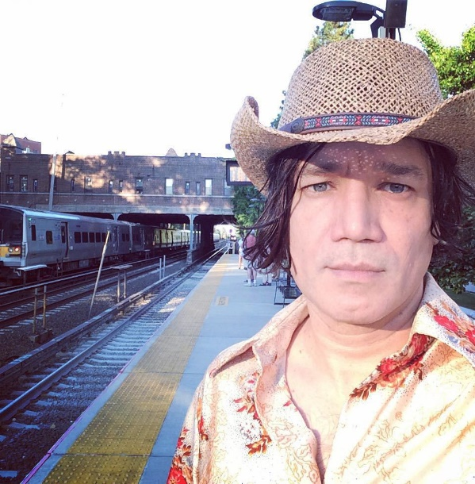
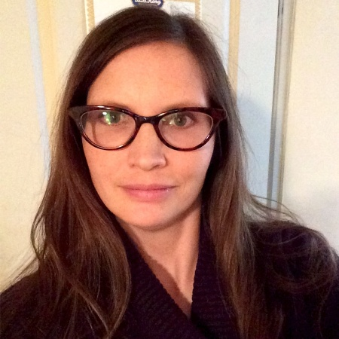
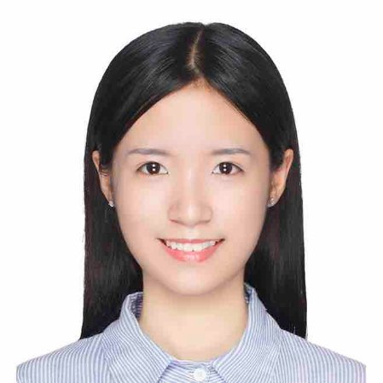
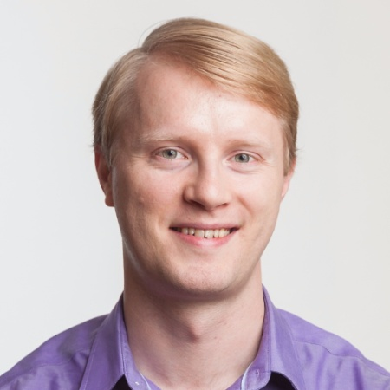
Meet the Team
SuprFanz is created and powered by a team of talented and dedicated people who care about what we do.
Ray Bernard
Jen Webb
Lihua (Lily) Xiong
Alexei Demchouk
CEO & Chief Architect
https://www.linkedin.com/in/ray-bernard-960382/
VP of Development
https://www.linkedin.com/in/jennifer-webb-b2658018/
Data Scientist
https://www.linkedin.com/in/lihua-lily-xiong-773400a6/
Data Scientist
https://www.linkedin.com/in/aleksod/
Notes:
This is our team. Ray Bernard is the heart and soul of SuprFanz who started it all and built the core application. I’m the co-founder and VP of development. We both wear many hats, but I mostly do front-end development design and UX. We have two young smart data scientists who help us out, Lily and Alexei.

Slide 5

Meet the Team
SuprFanz is created and powered by a team of talented and dedicated people who care about what we do.
Who is Cy?
We programmed Cy to use real-world promoter techniques and best practices every step of the way.
By hiring Cy to promote for you, you get top-shelf promotion intelligence built into your PR campaign.
It is like hiring a skilled publicist to tirelessly work for you 40 hours a week using social media to get folks to your events.
Notes:
Cy is our bot who makes all of this possible!

Slide 6

Cosmic Blues Band
Notes:
The SuprFanz story begins with my partner, Ray Bernard (aka Cosmic Ray) of the Cosmic Blues band in New York City. The Cosmic Blues Band landed a great gig, a residency at BB King’s in Times Square!

Slide 7
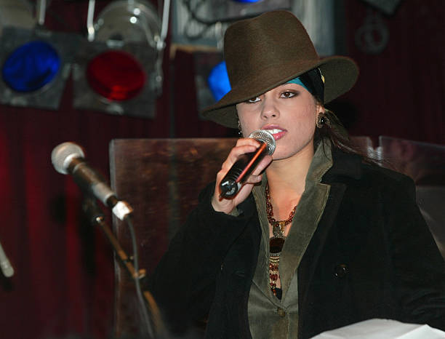
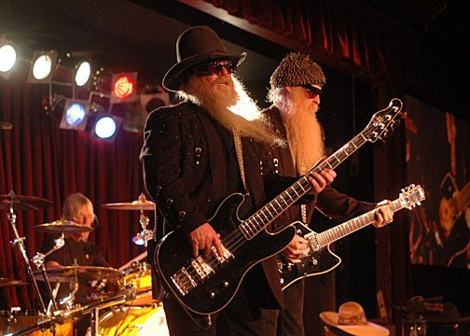
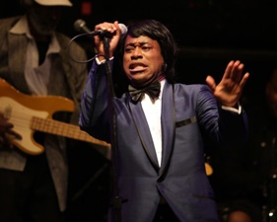
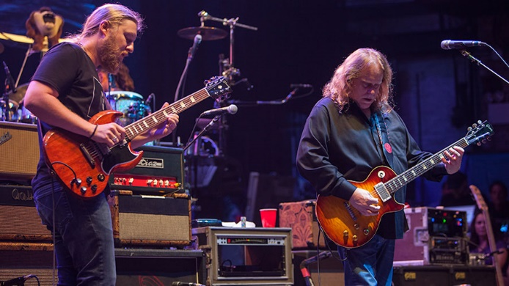
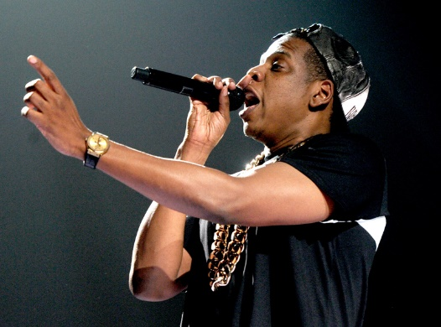
BB Kings
B.B. King Blues Club is one of NYC's premier Live Music Venues & Supperclubs.
Since opening in 2000, BB Kings has hosted some of the greatest music legends.
Aretha Franklin, James Brown, Alicia Keys, The Allman Brothers, Gipsy Kings, ZZ Top, & Jay Z have all performed on its stage, making it a must see destination for anyone who loves live music
http://www.bbkingblues.com/bio.php?id=8650

Slide 8
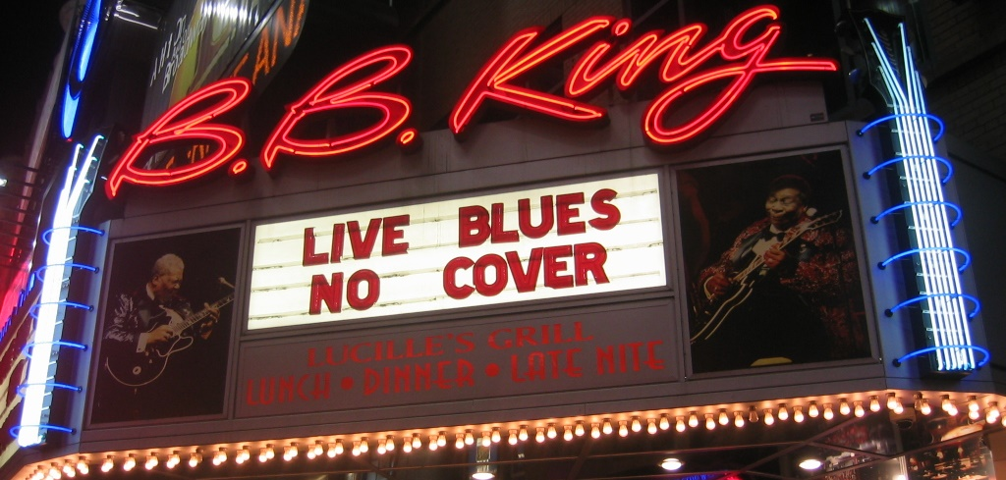
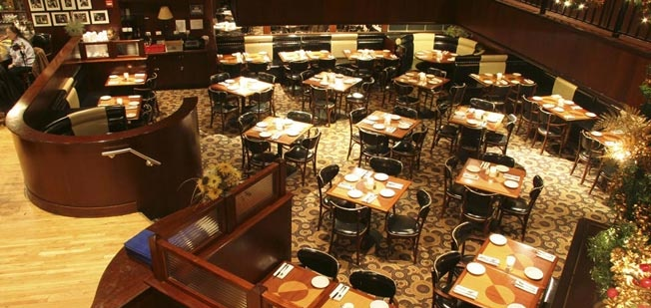
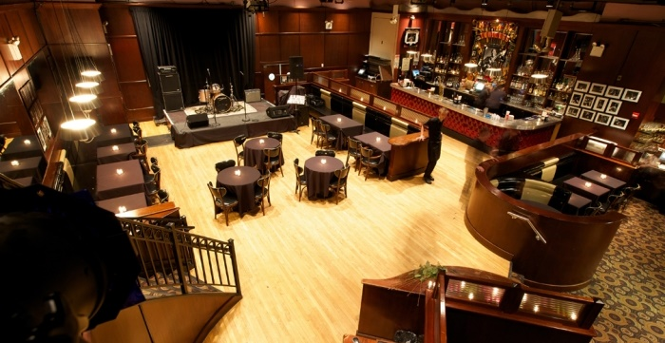
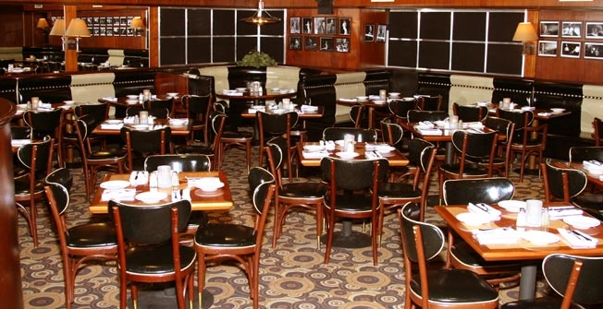
BB King’s Blues Bar / Lucille’s
Notes:
So Ray was presented with the problem of how to fill 120 capacity room every week. As a technologist with a background as a Columbia University adjunct professor and engineer working for big companies like Dell, Compaq and Isilon, his instinct was to approach this problem with technology.

Slide 9

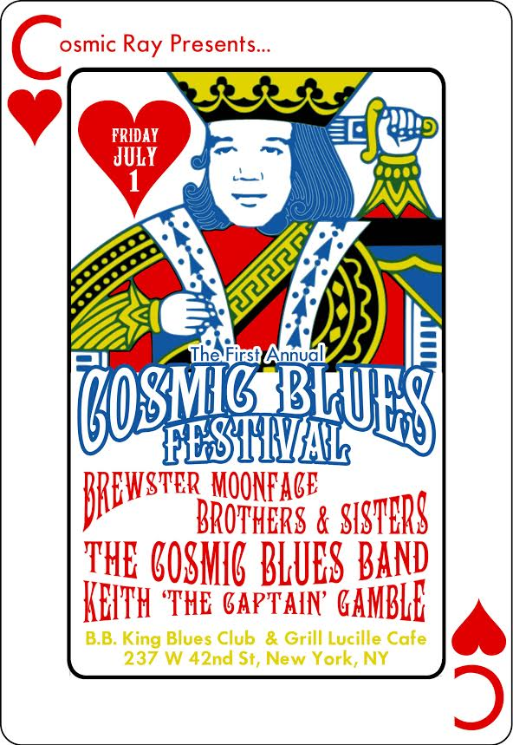

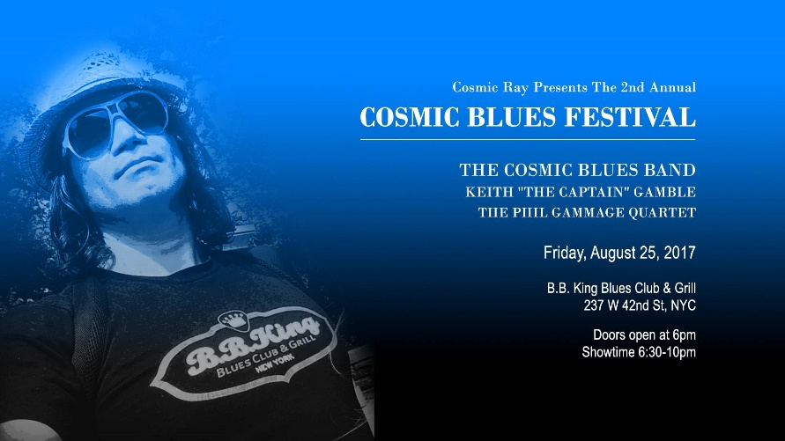
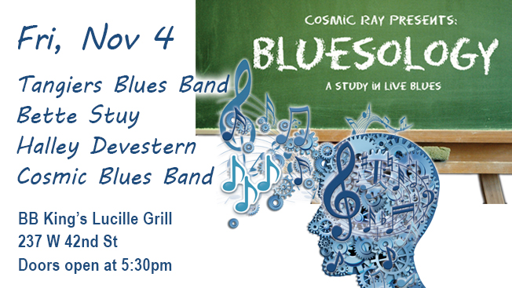
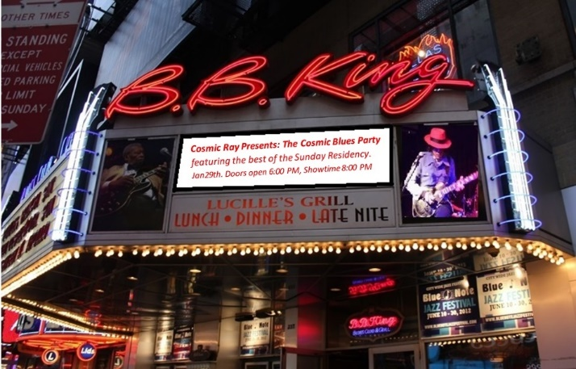
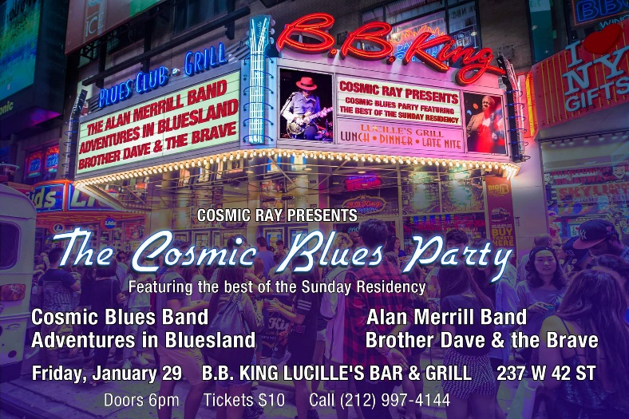
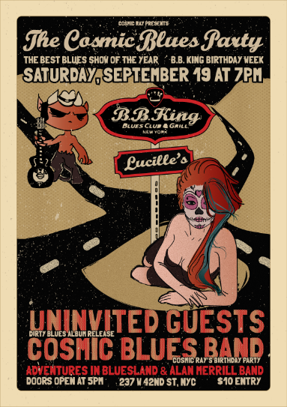
Notes:
Ray quickly made use of social media to start promoting like mad!
But as you probably know, it can take a person 10-20 hours a week or more to effectively market an event on social media and have some success.
So Ray decided to come up with a way to automate this at scale.

Slide 10
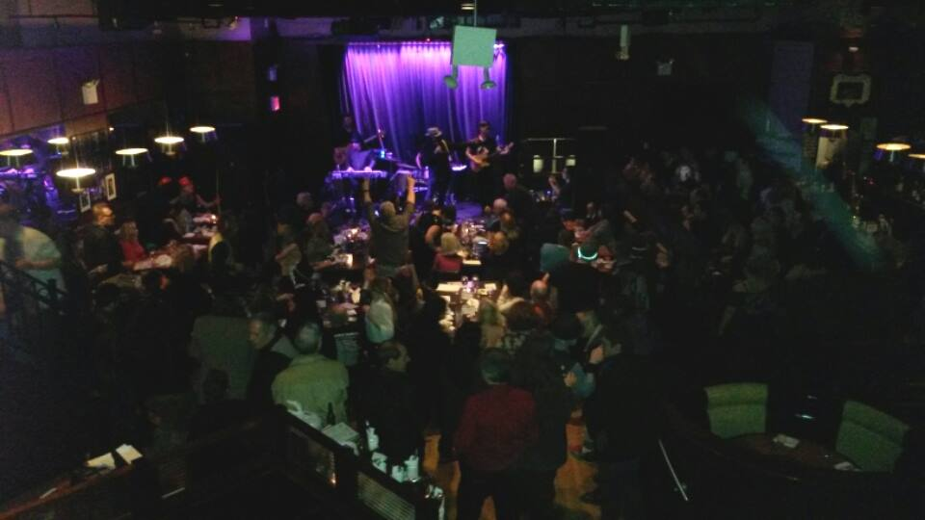
Notes:
As a musician myself, a keyboardist who’s played for the Cosmic Blues Band and a few others, when I first met Ray in New York, we learned that we share a passion for both music and technology.
When he told me about his idea, I was excited to work on it with him, especially when I saw the results live for myself in the form of a packed room.

Slide 11
What does SuprFanz do?
SuprFanz helps event promoters increase audience size.
We do this in a very personalized, active and thoughtful way at scale.
SuprFanz can do deep data analytics to discover the ‘SuprFanz’ within your social network.
SuprFanz saves an event promoter 10 to 20 hours of social media work per week.

Slide 12
How does SuprFanz do it?
SuprFanz grows a social network organically reaching out to a targeted fan base and creating a relationship with them.
SuprFanz can look at past events, targeting a similar fan base by social media, email, instant messaging or SMS!!!

Slide 13
A Recommendation Engine for Event Promoters!
SuprFanz is building a recommendation engine for event promoters to intelligently suggest where to target marketing efforts.
THIS
NOT THIS
Notes:
There’s a cost to every marketing effort in terms of time, labor and budget. SuprFanz helps you make every arrow count!

Slide 14
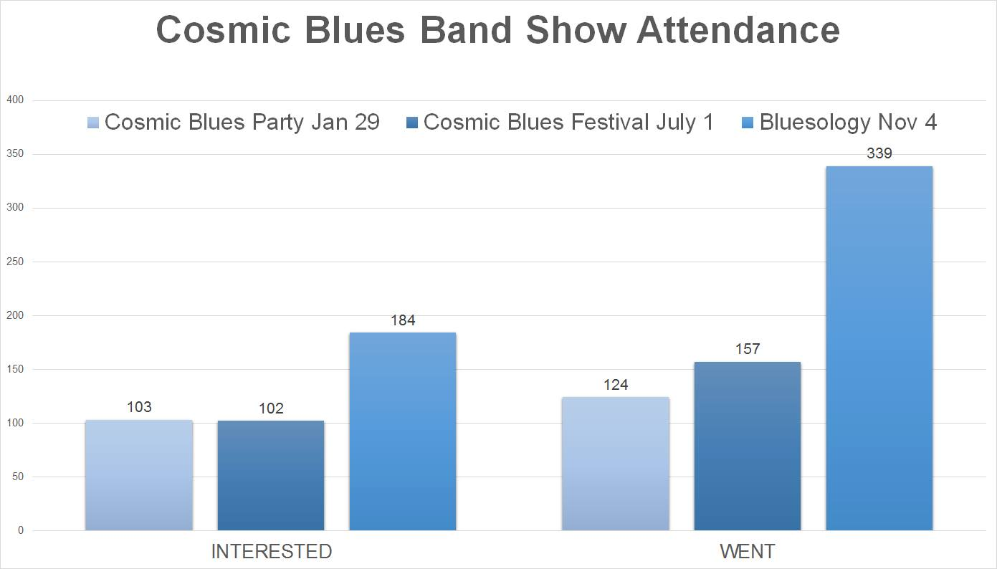
9 Months of Testing
2017
78.64%
173.39%
Notes:
And speaking of results, here are some that show that SuprFanz works.
Using a sample of 3 Cosmic Blues Band events at BB Kings in 2017, you can see that the number of Facebook users who RSVPed to the event as interested and going jumped by 79% and 173% respectively.
Same band, same venue. The main difference was how far developed our technology was at the time and how much we were promoting with it.

Slide 15
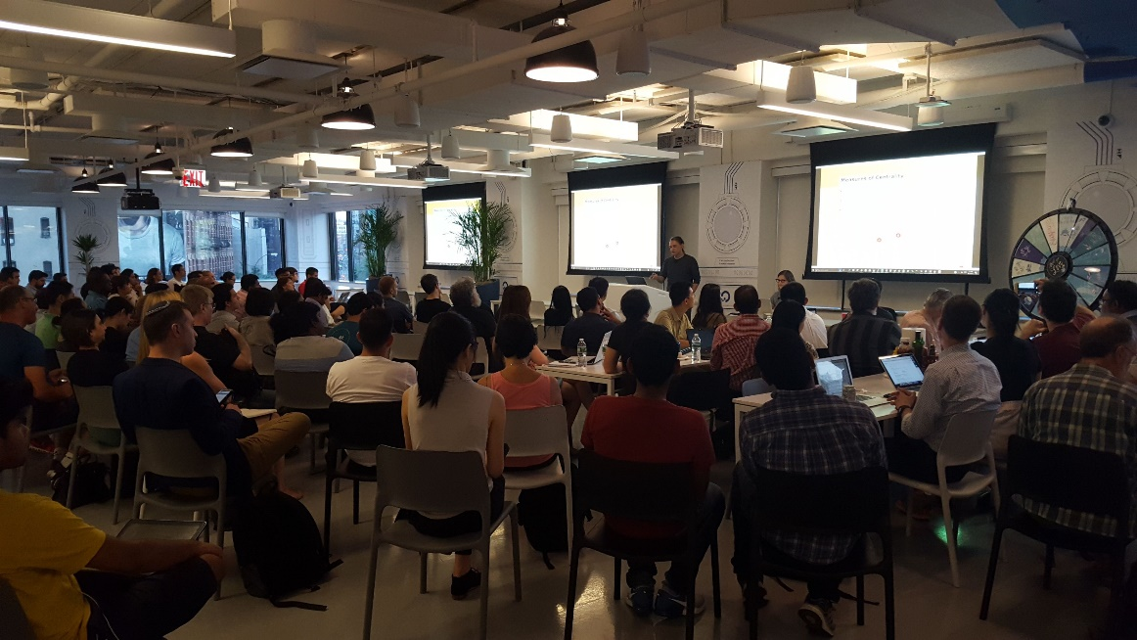
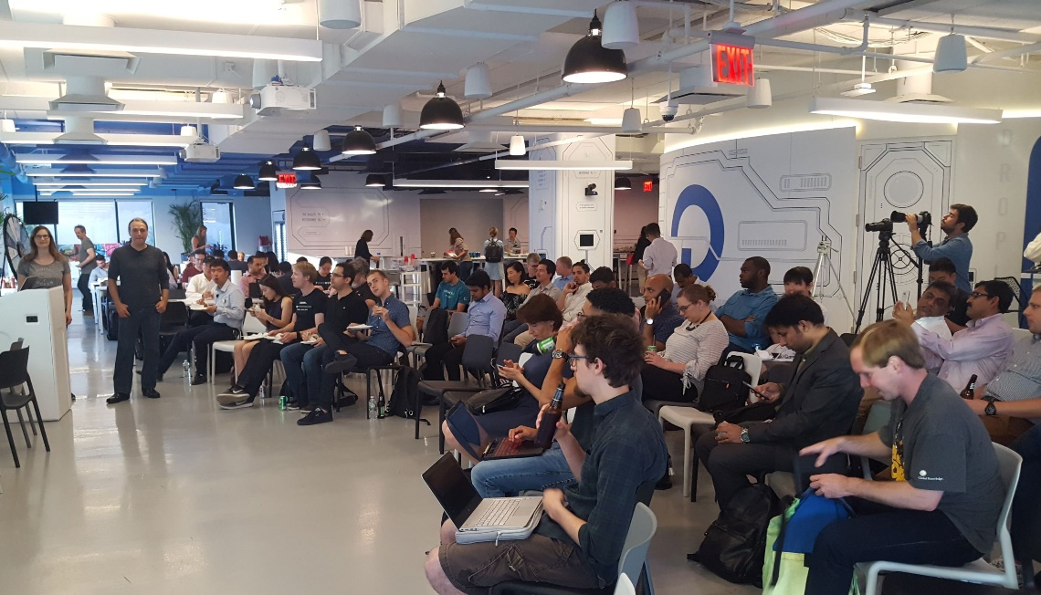
SuprFanz Works!
We know because we use it for our own events.
Our services are used to effectively market many types of events besides music
Our Aug 23, 2017 New York meetup hosted at Digital Ocean, received 456 attending RSVPs on Meetup.com and around 150 who actually attended.
Notes:
We realized that our model could be applied to events of all types, not just music. Whether its tech meetups, conferences, and corporate events

Slide 16



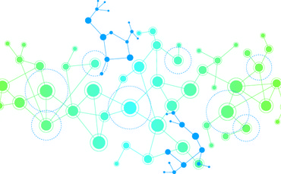






Harness the power of the Graph
Notes:
It was important to us to be able to provide intelligent insights to our users to help them promote events, otherwise we would be just like any other event marketing platform, and since our main platform was social media, we knew that graph databases were the way to go.

Slide 17
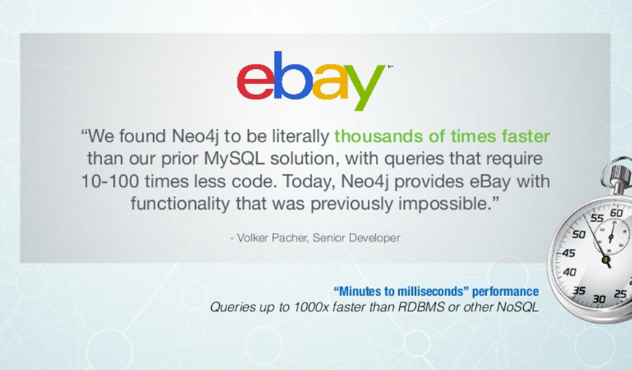
A great reference
Notes:
It was clear that Neo4j was the best choice based on some great references from large notable companies.

Slide 18

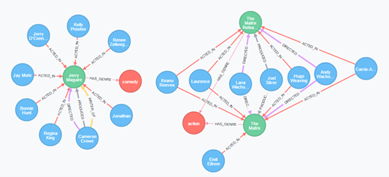
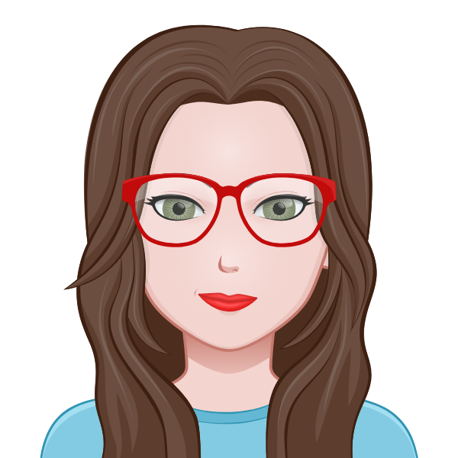

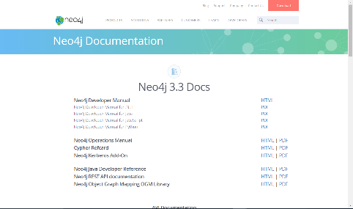
Why Neo4j?
Easy to go from the ideas in your head to creating a database for your domain
Lots of great help on getting started
Great documentation
Leader in market place
Great community
Notes:
They have a free online training course

Slide 19
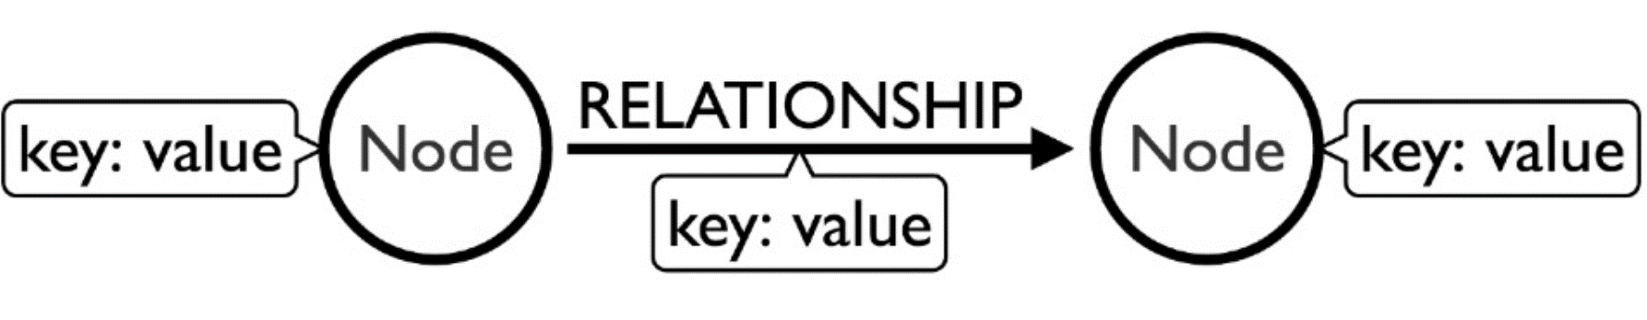
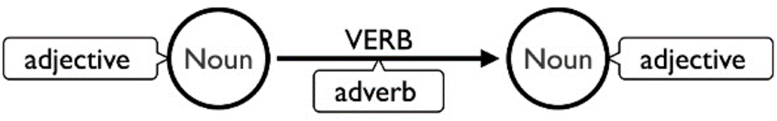
Property Graph
Source: Neo4j Intro to Cypher https://www.slideshare.net/neo4j/intro-to-cypher-78747369
Notes:
Here’s the most basic explanation of a property graph from Neo4j’s Intro to Cypher

Slide 20
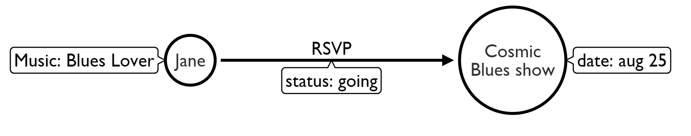




Property Graph example

Slide 21
Data Science can help us help our customers
Predict event attendance and returning RSVPs to future events (repeat customers)
Identify network influencers
Identify communities with the social network
Discover the ‘SuprFanz’
Notes:
We identified a few characteristics of SuprFanz. These are people who will like and follow you on social media, like and share your posts, respond immediately and enthusiastically and encourage their friends to come to the event too.
At the event, they’ll do things like check in, live video, take selfies and photos tagging friends.
After the event they may post more photos and videos and post about what a great time they had.

Slide 22
Data points for predicting attendance:
Event popularity in a network and whether or not friends are also attending (social factors)
Location/ Distance to venue (spatial factors)*
Time people are active (temporal factors) *
Past event behavior (indicative of interests and preferences)
Advanced ticket sales data or RSVPs
*Source: Who Will Attend? -- Predicting Event Attendance in Event-Based Social Network – X. Zhang, J. Zhao, G. Cao
Notes:
Here is where peer pressure is a good thing! There are strong social urges to share collective experiences with friends as well as to follow trends.
People tend to want to stay close to home, however some of the other factors can influence whether they’re willing to travel further.
Time people are most active. Generally events that happen when people are most active are more likely to be attended
Past event behavior is usually reflective of a person’s interests as well as whether they’re someone who likes to get out to a sheer volume of events. We can look at how often this person or social group attends events in general as well as semantic similarity* between those past events and future events. In addition we expect positive experiences and memories of a past event to be a strong motivation for attending a similar event in the future.
Predictions can be continuously updated every day ticket sales data is collected. This can also be applied to RSVPs on social media and event apps. The people who respond more quickly on these platforms have a greater likelihood of attending the event while people who don’t respond at all have a much lower likelihood.

Slide 23
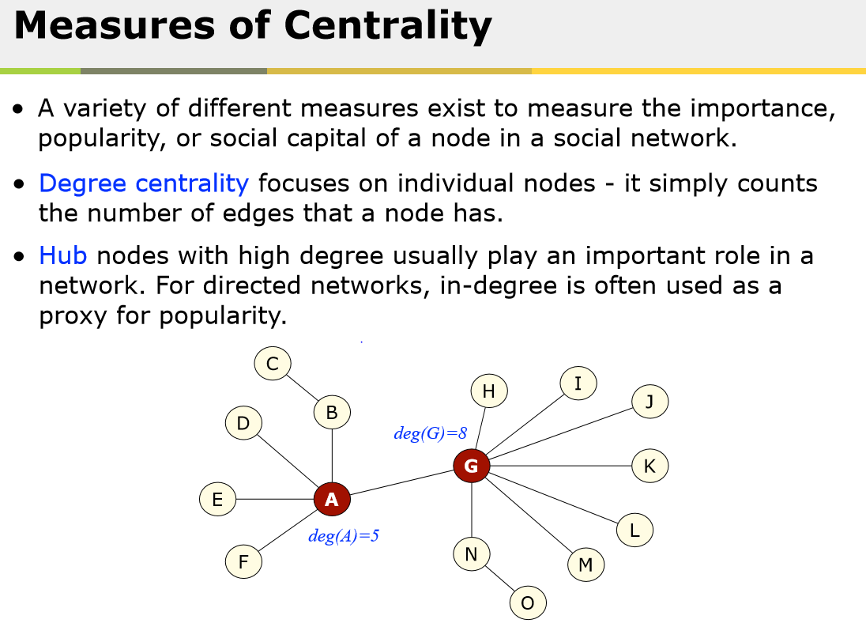
Source: Dr. Derek Green, Graph and Network Analysis. http://www.ic.unicamp.br/~wainer/cursos/1s2012/mc906/grafos.pdf
Notes:
Here’s a little bit more graph theory. Centrality is one way to identify influencers in a social network. One simple measurement is the degrees, which is the number of connections, edges, relationships each individual node has.

Slide 24
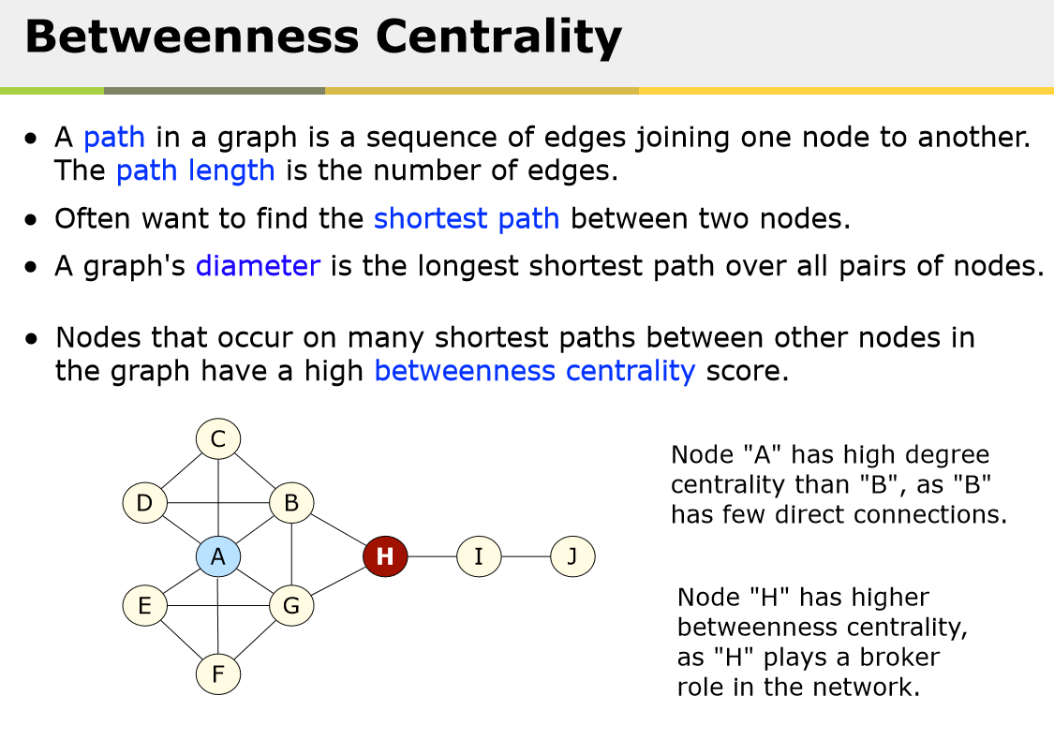
Source: Dr. Derek Green, Graph and Network Analysis. http://www.ic.unicamp.br/~wainer/cursos/1s2012/mc906/grafos.pdf
Notes:
Betweenness centrality calculates how many times a node acts as a bridge along the shortest path between other nodes.

Slide 25
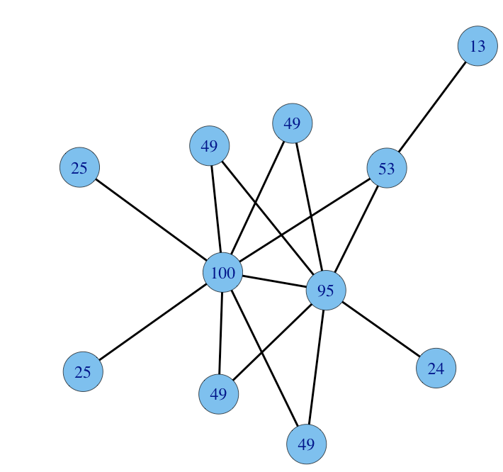
Eigenvector Centrality
In graph theory, eigenvector centrality (also called eigencentrality) is a measure of the influence of a node in a network.
It assigns relative scores to all nodes in the network based on the concept that connections to high-scoring nodes contribute more to the score of the node in question than equal connections to low-scoring nodes.
Source: Wikipedia - Graph Theory. https://en.wikipedia.org/wiki/Graph_theory
Notes:
This also the basis of the Google PageRank which assigns a score to a web page based on the number of links to that page but also factoring the number of links each of those pages have and so on.

Slide 26
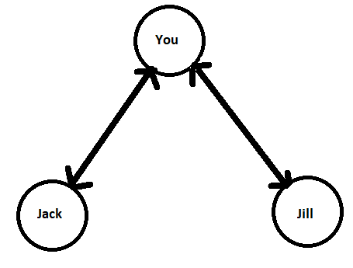
Triadic Closures
The property among three nodes A, B, and C, such that if a strong tie exists between A-B and A-C, there is a weak or strong tie between B-C.^{[2]} This property is too extreme to hold true across very large, complex networks, but it is a useful simplification of reality that can be used to understand and predict networks.^{[3]}
A
Friends
Friends
B
C
Source: https://en.wikipedia.org/wiki/Triadic_closure
Notes:
A triadic closure is a simple prediction that when there is a relationship between A-B and A-C, there is a possibility that a tie exists or could form between B and C.

Slide 27
Triadic Closures
FRIENDS
FRIENDS
FRIENDS
Notes:
Example, if you are friends with Jack and you are friends with Jill, there’s a strong likelihood that Jack and Jill will meet and become friends

Slide 28
Triadic Closures
A local bridge occurs, when a node is acting as a gatekeeper between two neighboring nodes who are not otherwise connected. In a network that follows the Strong Triadic Closure Property, one of the ties between nodes involved in a local bridge needs to be a weak tie.
Local Bridge
Ann
Friends
Friends
Friends
Friends
Friends
Friends
Bill
SAM
Bosses
Source: https://en.wikipedia.org/wiki/Triadic_closure
Notes:
An example of a local bridge is how when you look for a job you likely need to go outside of your own social network to find a network of bosses

Slide 29
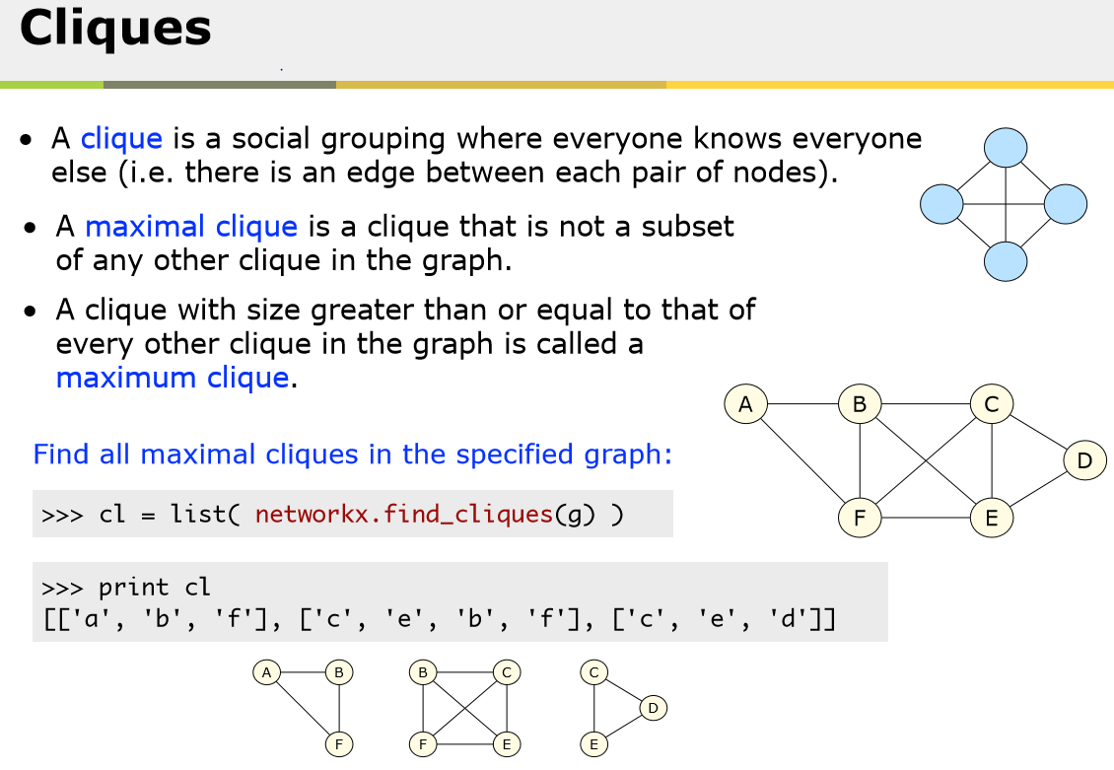
Source: Dr. Derek Green, Graph and Network Analysis. http://www.ic.unicamp.br/~wainer/cursos/1s2012/mc906/grafos.pdf
Notes:
Cliques are an important form of community detection shown by groups of nodes all connected to each other.
When event guests know each other they it can be a strong vehicle for growing event popularity quickly.

Slide 30
Putting these concepts into Practice
Notes:
Now to show you a bit of some of what we’re doing at SuprFanz to put these concepts into practice

Slide 31
Neo4j Community-Graph
Meetup
Twitter
GitHub
StackOverFlow
Power view of your community in a single plan view.
Keep track of a technical community in near real time.
Identify who are the community thought leaders
Identify technical key trends.
Notes:
We were fortunate enough to be introduced to the Community-Graph, an open source project lead by Neo4j
The Community-Graph provides a multidimensional view of data from multiple social media platforms combined into a single view.
Twitter, meetup, GitHub and Stack Overflow.
The Community-Graph allows you to shape your data based on tags you provide (e.g. ‘Data Science’, ‘Neo4j’, ‘Graph Databases’)
All views are based on these tags and filter the content of the graph database allowing you to take a pulse of the community as it happens in real time.
We leverage the Community-Graph to provide insights about our target audience

Slide 32
Community-Graph
Provides live API feeds based on Filtered tags
We use Data Science to find out who is important in our Community
Twitter | Github | Stack Overflow | Meetup
Users | Projects | Problem | Group
Tweets | Owners | Questions | Events
Retweets | Repositories | Answers | Attendees*
https://github.com/community-graph

Slide 33
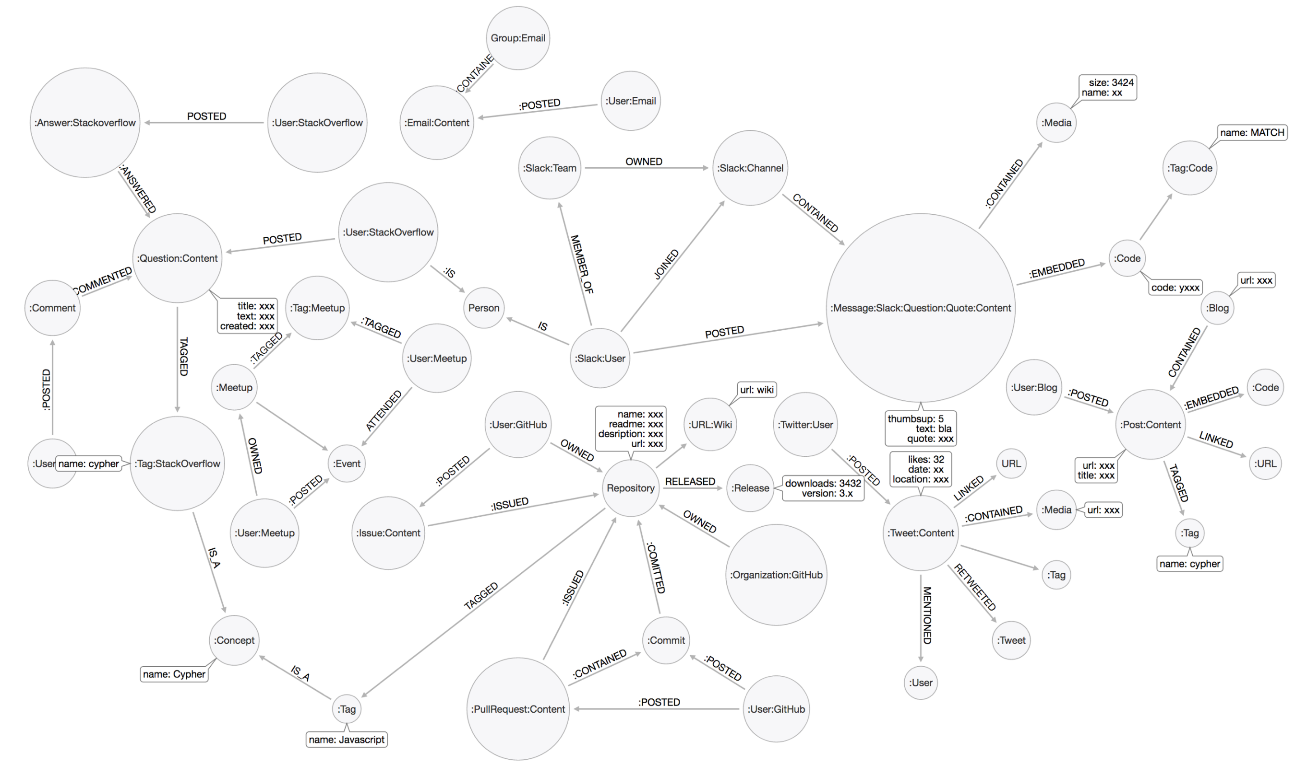
Community-Graph Data Model
Notes:
We are looking at Tweeter and Meetup Data elements today

Slide 34
Graph Algorithms Plugin for Neo4j
Centralities
These algorithms determine the importance of distinct nodes in a network.
Page Rank (algo.pageRank)
Betweenness Centrality (algo.betweenness)
Closeness Centrality (algo.closeness)
Harmonic Centrality (algo.harmonic)
Community Detection
These algorithms evaluate how a group is clustered or partitioned, as well as its tendency to strengthen or break apart.
Louvain (algo.louvain)
Label Propagation (algo.labelPropagation)
(Weakly) Connected Components (algo.unionFind)
Strongly Connected Components (algo.scc)
Triangle Count / Clustering Coefficient (algo.triangleCount)
Path Finding
These algorithms help find the shortest path or evaluate the availability and quality of routes.
Minimum Weight Spanning Tree (algo.mst)
All Pairs- and Single Source – Shortest Path (algo.shortestPath, algo.allShortestPaths)
Notes:
Graph Algorithms are a library of stored procedure plugins you get with 3.1 and up
With Neo4j plugins you no longer have to export your data for analysis and then reimport to visualize
Depending on your data and model, some of these will be a better fit than others

Slide 35
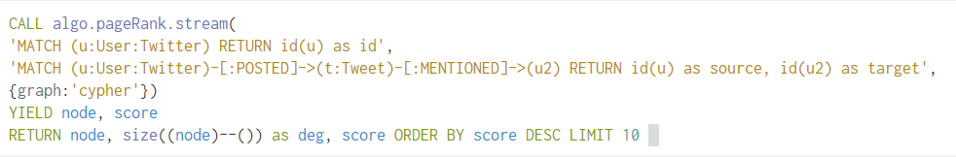
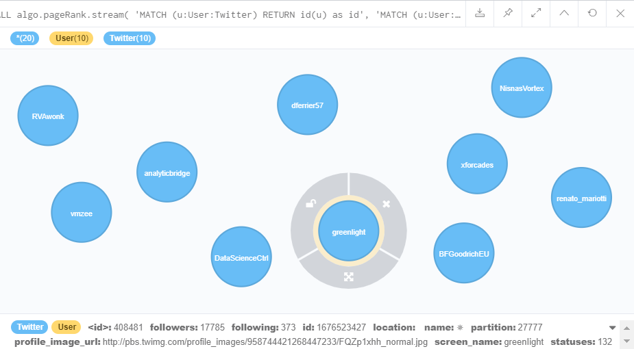
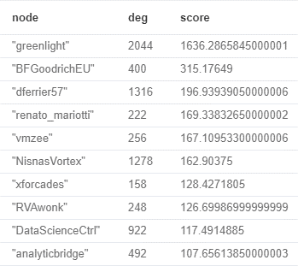
Page Rank: Twitter
Notes:
Before I show these algorithm examples, I want to take a moment to thank our Data Scientist on board, Lily Xiong from New York who really helped us with applying the algorithms to the data we have. These examples are based on her work.
We run these algorithms in the Neo4j browser of our database using Cypher, Neo4j’s query language.
Degrees is the number of relationships that node has, and the score is their weight (Eigenvector centrality)

Slide 36
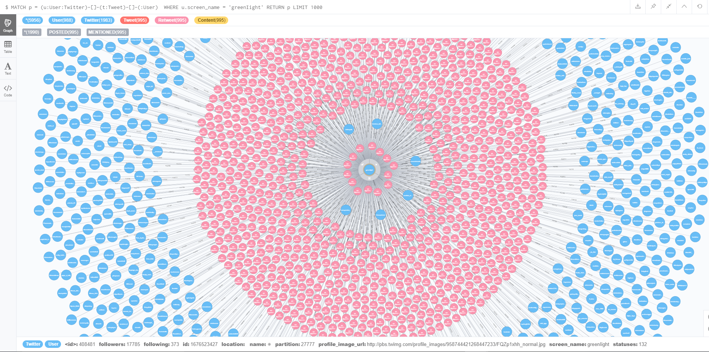
Top Ranker’s Graph
Notes:
Blue nodes are Twitter Users and pink nodes are retweets

Slide 37
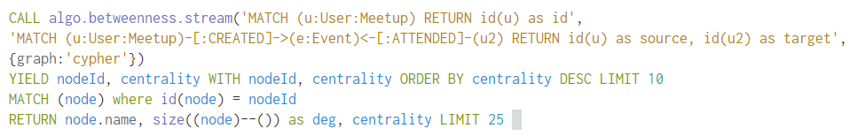
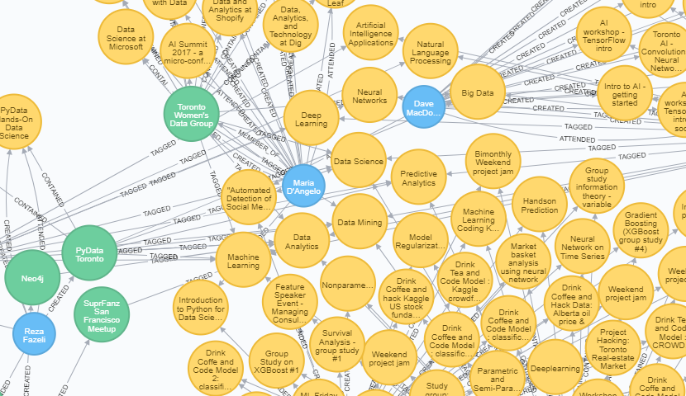
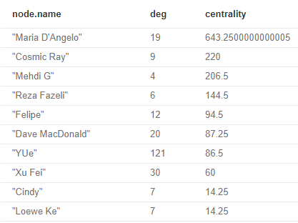
Betweenness Centrality: Meetup
CALL algo.betweenness.stream( 'MATCH (u:User:Meetup) RETURN id(u) as id', 'MATCH (u:User:Meetup)-[:CREATED]->(e:Event)<-[:ATTENDED]-(u2) RETURN id(u) as source, id(u2) as target', {graph:'cypher'}) YIELD nodeId, centrality WITH nodeId, centrality ORDER BY centrality DESC LIMIT 10 MATCH (node) where id(node) = nodeId RETURN node, size((node)--()) as deg, centrality
Notes:
Maria is very central in this Toronto Data Science community meaning a lot of nodes have to go through her to get to other nodes
Cosmic Ray is high on this list too because Ray shaped the data in this graph, was actively promoting and connecting with various meetup groups and promoting his events
Using our SuprFanz application, he was able to bring up his centrality by actively promoting meetups at scale.

Slide 38
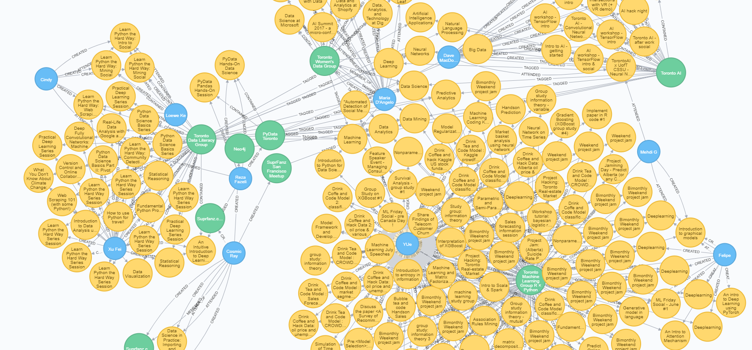
Example of Meetup Betweenness Centrality
CALL algo.betweenness.stream( 'MATCH (u:User:Meetup) RETURN id(u) as id', 'MATCH (u:User:Meetup)-[:CREATED]->(e:Event)<-[:ATTENDED]-(u2) RETURN id(u) as source, id(u2) as target', {graph:'cypher'}) YIELD nodeId, centrality WITH nodeId, centrality ORDER BY centrality DESC LIMIT 10 MATCH (node) where id(node) = nodeId RETURN node, size((node)--()) as deg, centrality
Notes:
YUe has a high number of edges (degrees) because he creates a lot of meetup events and content, but his individual nodes are not as interconnected as Maria’s

Slide 39
Triangle Counting
When to use it / use-cases
Triangle counting has gained popularity in many other domains including:
computer network security - intrusion detection and spamming
web applications - community detection and blog analysis
social network analysis - link prediction, spam filters, content quality control
biological networks - protein-protein interaction analysis

Slide 40
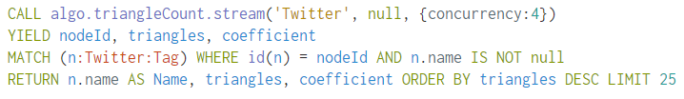
Triangle Clustering Coefficient
In graph theory, a clustering coefficient is a measure of the degree to which nodes in a graph tend to cluster together.
Find Clustering around Twitter Tags
Notes:
Evidence suggests that in most real-world networks, and in particular social networks, nodes tend to create tightly knit groups characterized by a relatively high density of ties; this likelihood tends to be greater than the average probability of a tie randomly established between two nodes.

Slide 41
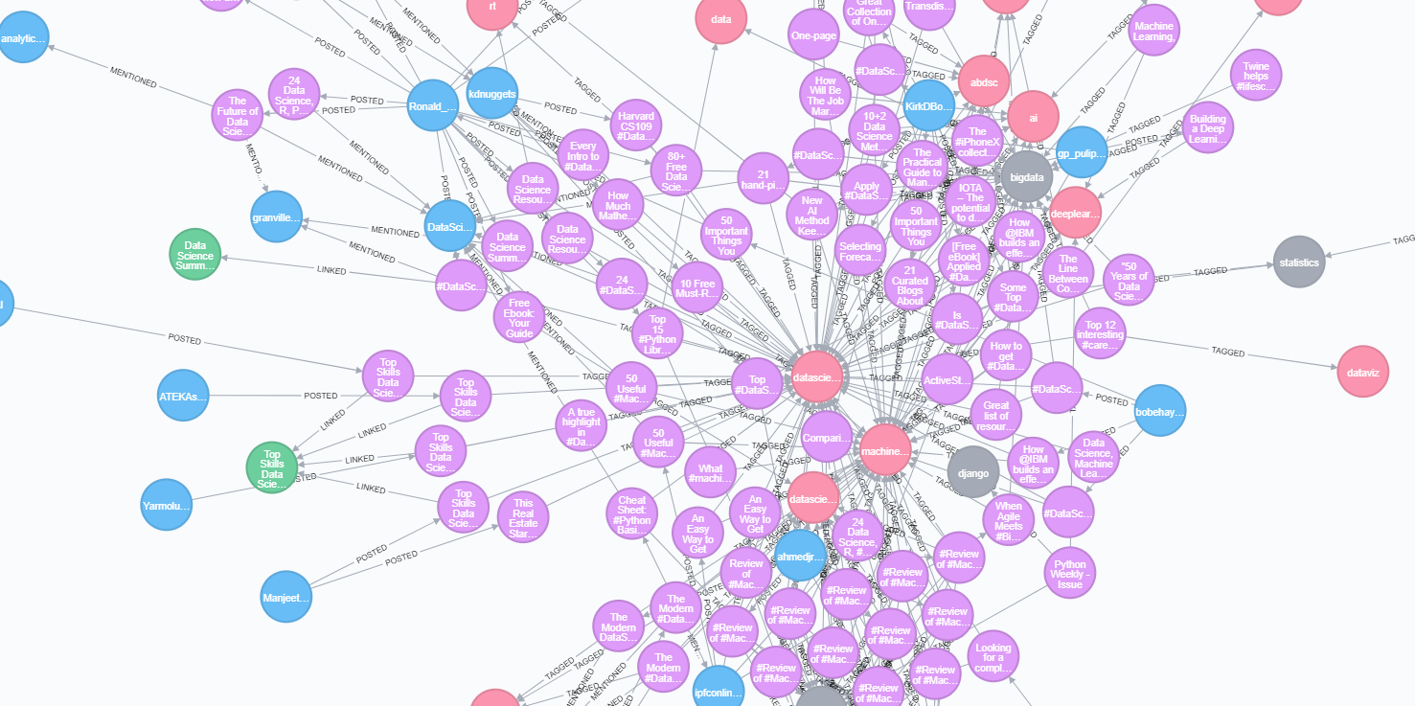
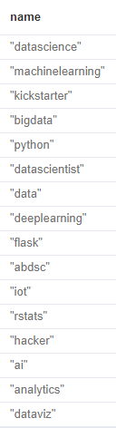
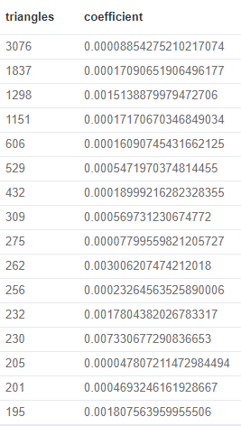
Triangle Count for Twitter Tags
Notes:
With a Triangle Count we can look for clustering around particular Twitter Tags to see which terms will reach more members of a community.
Here in our data science based graph we can see that the term ‘datascience’ is widely used and with a very active community cluster around it but ‘dataviz’ not as much.
This information can be useful when deciding what hashtags will have the most impact if used in our limited character tweets

Slide 42
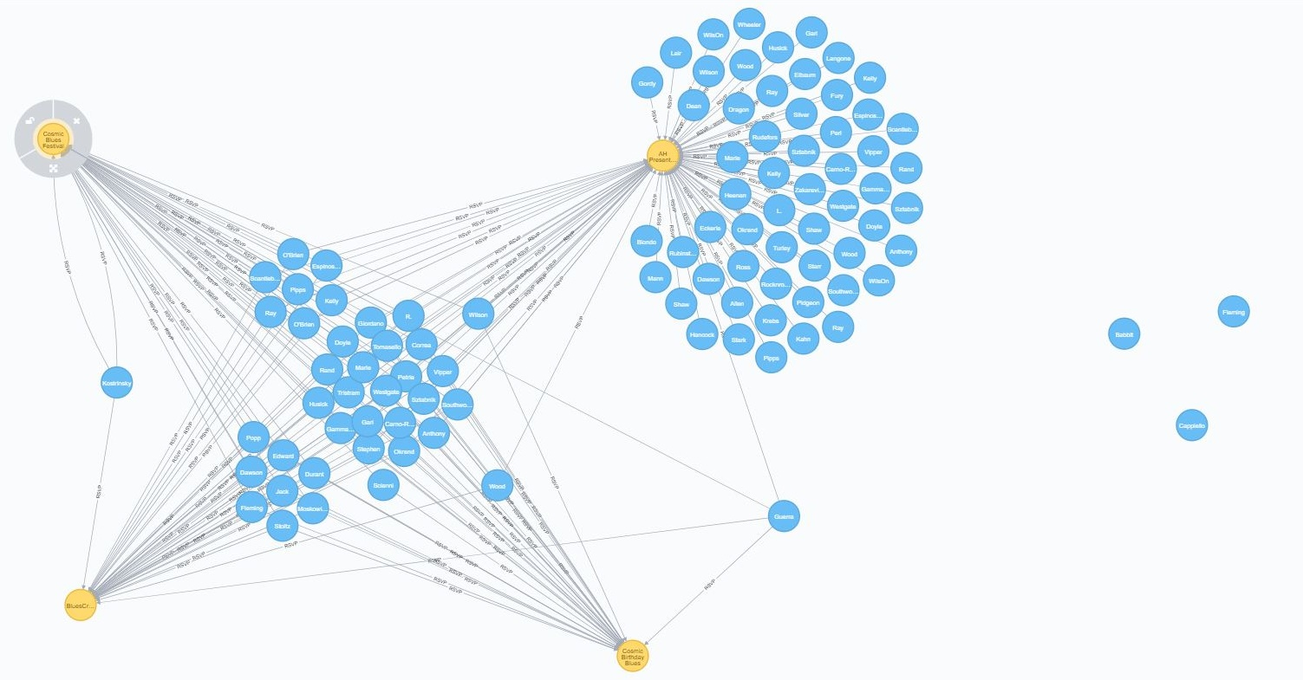

Degree Count: Facebook
CALL algo.pageRank.stream('MATCH (u:cosmic:fb_guest) RETURN id(u) as id', 'MATCH (n1:fb_event)<-[:RSVP]-(u:fb_guest) RETURN id(u) as source, id(n1) as target', {graph:'cypher'}) YIELD node, score RETURN node, size((node)--()) as deg ORDER BY deg DESC LIMIT 100
Notes:
At the moment, Facebook data is not currently included in the open source Community Graph, however we at SuprFanz have done a lot of work with Facebook events.
Here we have a subgraph view showing two Cosmic Blues band events and two other music events in New York within the same social community
Right away you can see that the events share several common guests
In this example we are using a simple Degree count to show us which Facebook users are attending the most events in the complete graph of this data set.

Slide 43


Degree Count: Facebook
CALL algo.pageRank.stream('MATCH (u:cosmic:fb_guest) RETURN id(u) as id', 'MATCH (n1:fb_event)<-[:RSVP]-(u:fb_guest) RETURN id(u) as source, id(n1) as target', {graph:'cypher'}) YIELD node, score RETURN node, size((node)--()) as deg ORDER BY deg DESC LIMIT 100
Notes:
When we expand the visualization to include more events, you can see two community groups that are separate but have one node that acts as a broker between the two networks
As a promoter on the left you want to find ways to reach the people on the right by finding paths through this broker

Slide 44

Shortest Path: Facebook
Notes:
Here is a graph of Facebook blues music events in New York with some guests in common.
Problem: How can the Promoter of the Cosmic Blues Festival reach those guests of the Bluescraft event that they don’t already share?
We’ll use the node John in this example.

Slide 45


Shortest Path: Facebook
Notes:
This particular use case is a stepping stone to further analysis.
We can explore Christa’s relationships to see if we can find other connections to John’s network through which we can target promotions
Examples:
If they are already friends and Christa shares the event or page posts about it
If they are members of the same Facebook group and Christa posts in the group
If they like the same pages, photos or other public content in which the event is the topic
They could meet in person at the Bluescraft event

Slide 46
Just a glimpse
Notes:
And this has been a small snapshot of the many ways we are exploring the use of data science to help our users increase event attendance

Slide 47
Tools from SuprFanz
One-page Flask application which uses the Facebook SDK to login and mine event data then renders it using D3.
Includes a module to import Facebook events ... Can be used as standalone
Includes a module to convert data from Neo4j into d3.json visualization format.
SuprFanz open source app on Github https://github.com/suprfanz/flask-fb-neo4j-d3

Slide 48
Contact SuprFanz
www.suprfanz.com
ray@suprfanz.com
jen@suprfanz.com
@Suprfanz
We are looking for Devs and Data Scientists to join our early stage startup.

Slide 49

SuprFanz Bay Area Meetups
Data Science in Practice: Importing and Visualizing Facebook Data Using Graphs!
Wednesday, March 7, 2018 6:00 PM to 8:00 PM H2O Building 2, 2301 Leghorn Mountain View, CA https://www.meetup.com/SuprFanz-San-Francisco-Meetup/events/248011852/
Thursday, March 8, 2018 6:00 PM to 8:00 PM MuleSoft, 77 Geary Street San Francisco, CA https://www.meetup.com/SuprFanz-San-Francisco-Meetup/events/247968946/

Slide 50
In Closing
Discussed how we use data science to help our customers promote events and discover their ‘SuprFanz’
Introduced Neo4j Graph Algorithms and the Community-Graph
Showed examples of using the Graph Algorithms with the Community-Graph data set and Facebook event data
Contact us if you would like help promoting your events!

Slide 51
Helpful links for learning the material covered
Neo4j https://neo4j.com/developer/ https://neo4j-contrib.github.io/neo4j-graph-algorithms/#_introduction
Community-Graph https://github.com/community-graph
Dr. Derek Green, Graph and Network Analysis http://www.ic.unicamp.br/~wainer/cursos/1s2012/mc906/grafos.pdf
An analysis of Twitter Influencers in the field of Data Science & Big Data https://medium.com/@swainjo/an-analysis-of-twitter-influencers-in-the-field-of-data-science-big-data-48b0809027ef
Notes:
We can help with installing the Community-Graph
For help with promotions, please contact us to arrange a consultation

Slide 52
Thank you!!
Notes:
© SuprFanz 2018

